Slide 1
Mushroom Quality Project
-Nikhil Shimpi

Slide 2
Libraries Used
Numpy
Pandas
Seaborn
Matplotlib
Sklearn
XGBoost

Slide 3
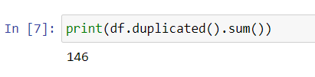
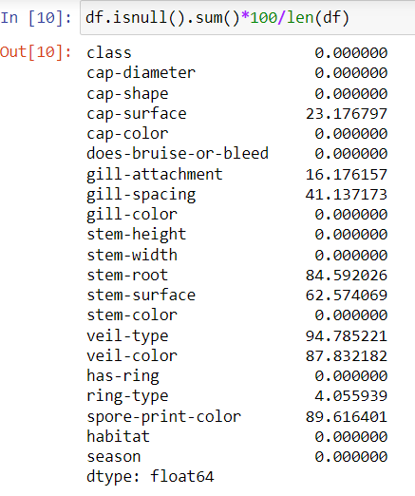
Data Imputation and Preprocessing
There are 146 duplicate rows in dataset which are removed from dataset.
There are many null values in dataset
Where the total null values are greater than 60% those colomns are removed from dataset
Colomns which are having less null values are imputed using mean if it is numerical data and mode if it is categorical data
All attributes of data are replaced with metada information for better visualization of data.

Slide 4
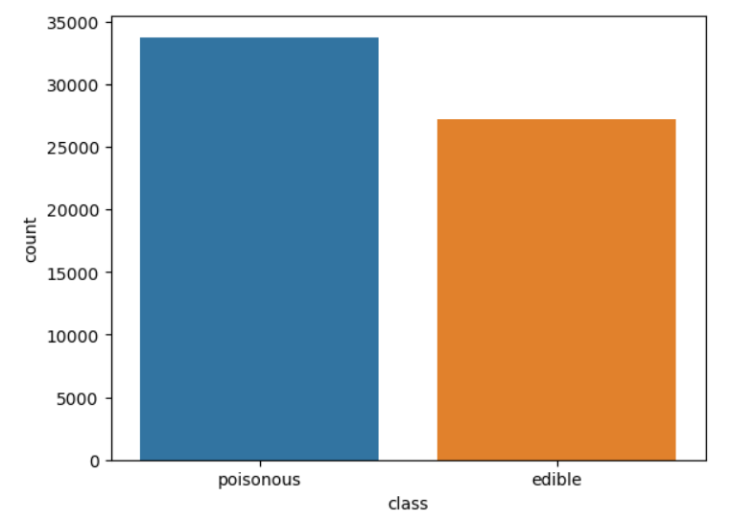
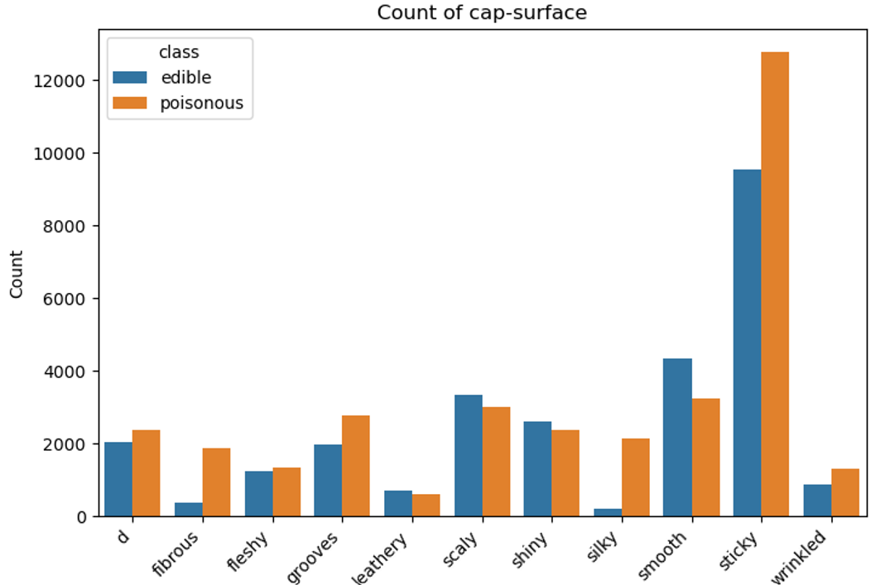
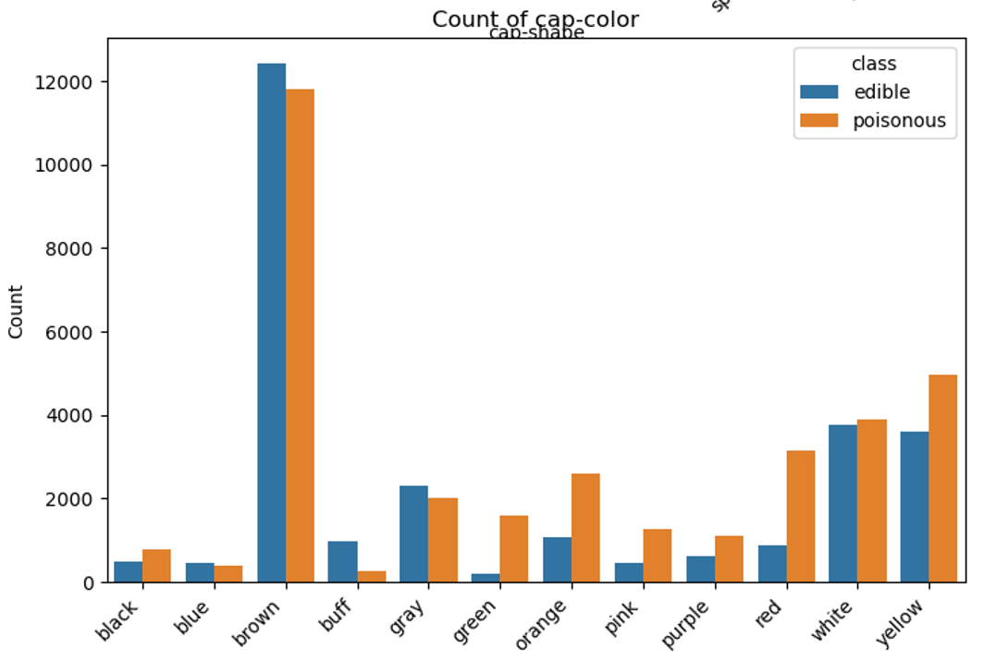
Data Insights – CountPlots
No imbalance dataset
If mushroom cap-suface is fibrous or silky then there is more chance of it is poisonous
If mushroom cap-color is buff then there is more chance of it is edible
If mushroom cap-color is green then there is more chance of it is poisonous

Slide 5
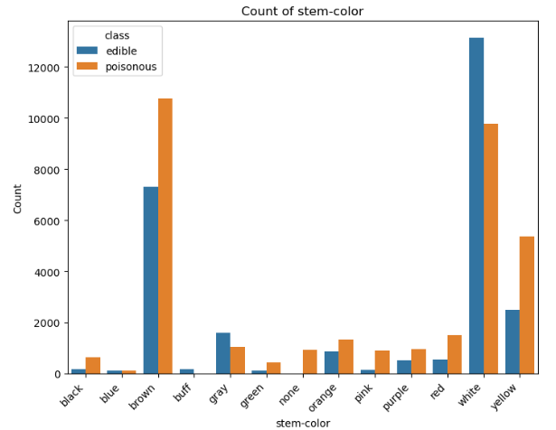
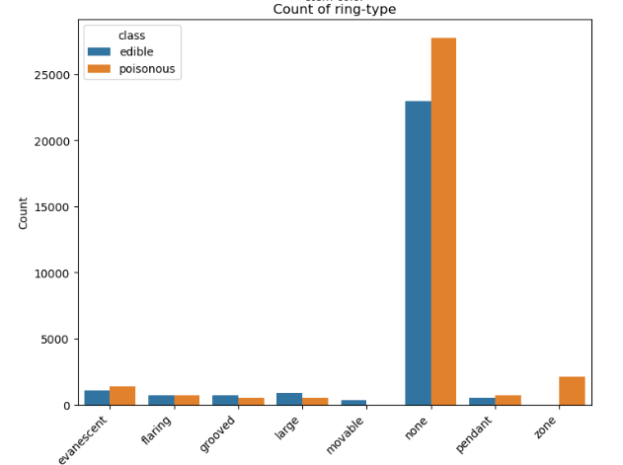
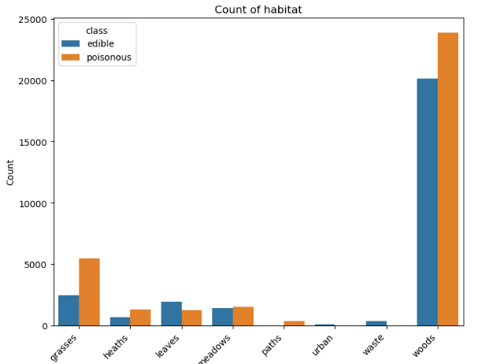
Data Insights – CountPlots
If mushroom stem-color is buff then there is more chance of it is edible
If mushroom stem-color is green, pink or black then there is more chance of it is poisonous
If mushroom ring-type is zone then there is more chance of it is poisonous
If mushroom ring-type is movable then there is more chance of it is edible
If mushroom habitat is urban or wasste then there is more chance of it is edible
If mushroom habitat is paths then there is more chance of it is poisonous

Slide 6
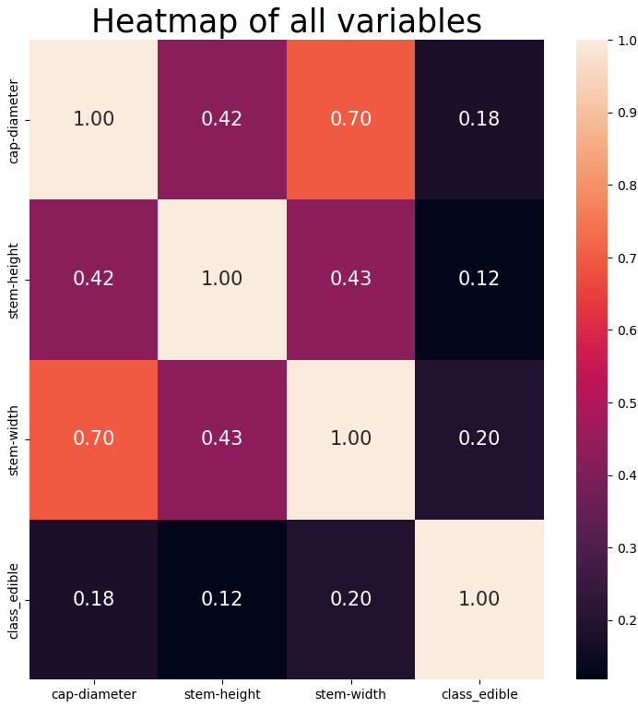
Data Insights - HeatMap
Medium correlations =
Stem width with cap diameter
Stem height with cap diameter
Stem height with stem width
Low correlations =
All variables are least correlated with target variables.

Slide 7
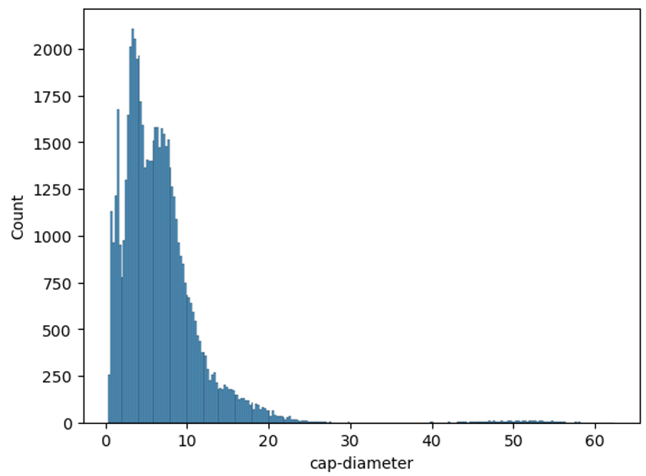
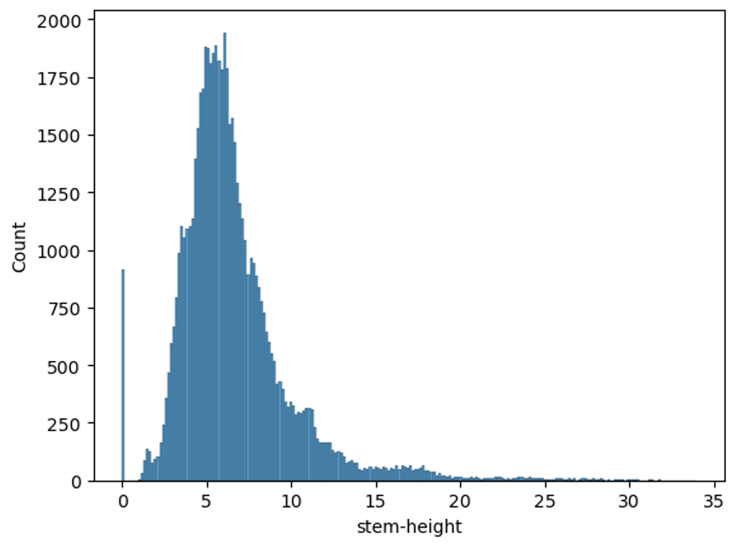
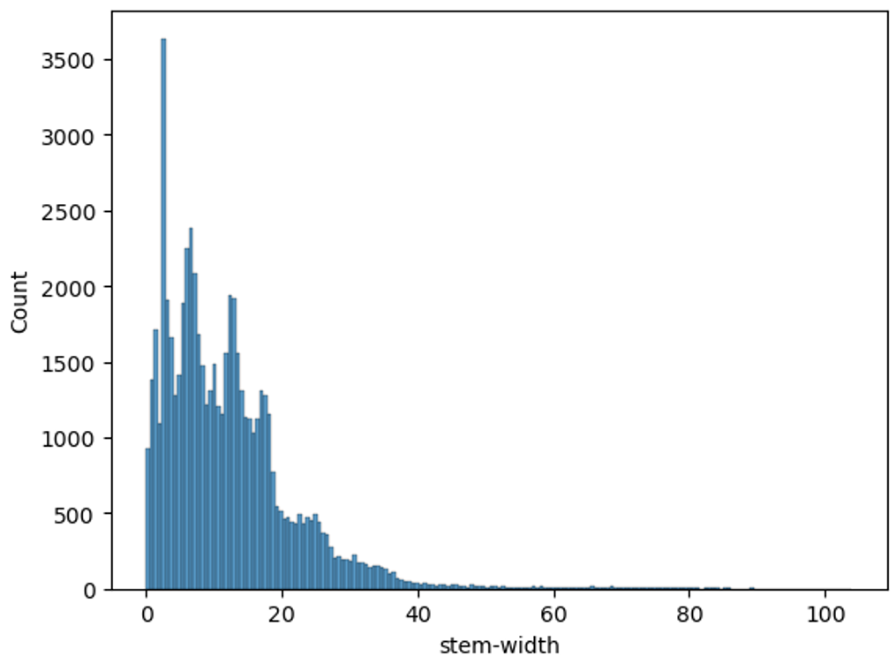
Data Insights - Histograms
Histograms shows that cap-diameter, stem-height and stem-width have nearly right skewed distributions.

Slide 8
Data Processing
One hot encoding done for categorical colomns.
Standard scaling is done for all colomns.

Slide 9
Models Used
“Logistic Regression": LogisticRegression(),
"K-Neighbors Classifier": KNeighborsRegressor(),
"Support Vector Classifier":SVC(),
"Gaussian Naive Bayes":GaussianNB(),
"Decision Tree Classifier ": DecisionTreeClassifier(),
"Random Forest Classifier ": RandomForestClassifier(),
"XGB Classifier ": XGBClassifier()

Slide 10
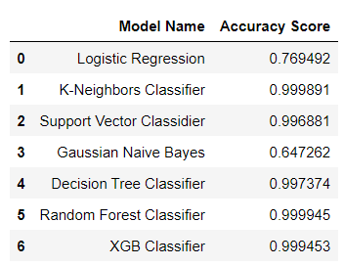
Results

Slide 11
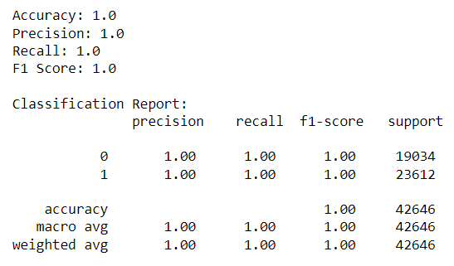
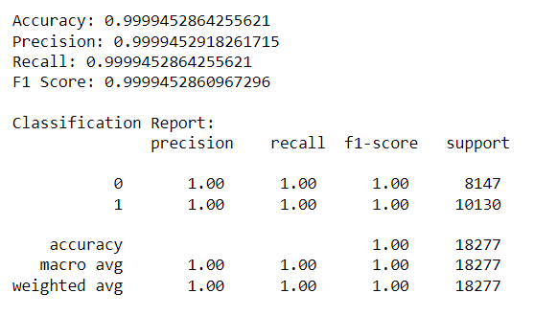
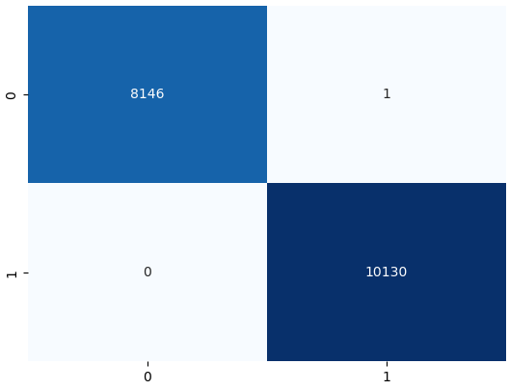
Best Model - Decision tree classifier
Model performance of Training set
Model performance of Test set
Confusion matrix

Slide 12
Thank You

